Slide 1
Web (Part 1)
Next time
Document ready() like main()
HTML class vs Java class, sort of similar concepts but not quite, and used for very different things
Programming Usable Interfaces (PUI)
05-430/05-630 Fall 2018
Jason Hong
jasonh@cs.cmu.edu
Notes:
Video to load

Slide 2
Today
Practical web concepts
Document Object Model, what it is, querying it
Some tips for effective web programming
Structure and organization of GUIs
Next lecture
History of the web

Slide 3
Some Background
Why learn HTML + CSS + JavaScript?
Harder to do rapid prototyping
Messy, harder to do debugging, lots of gotchas too
Evolved from a way to represent documents to supporting full-scale networked applications
…but, alumni feedback
Often requested in alumni surveys
Informal conversations with alumni too
Good for your portfolios and skill set

Slide 4
HTML, CSS, and JavaScript
HTML is the content of a web page
CSS is the presentation
Layout, colors, size
JavaScript is the programming side
HTML has basic behaviors (links, buttons)
JavaScript enables sophisticated behaviors
All three are linked together

Slide 5
The Document Object Model
Let's start with one of the most important concepts: the DOM
The DOM is how programs can access and modify HTML
The HTML DOM views an HTML document as a tree structure
Each node in tree is an HTML element.
Nodes can have attributes

Slide 6
Structure of HTML Page as DOM
HTML
<html>
<head>
<title>
Hello World!
</title>
</head>
<body>
<h1> Hello </h1>
<div>some text</div>
</body>
</html>
What JavaScript Sees
document
head
title
body
h1
“hello”
div
“some text”
“hello world!”
Notes:
Note that there is a hidden root node called document

Slide 7
The Document Object Model
Each HTML tag gets parsed into an element into the DOM tree
“Parsed” is a CS term for reading and processing
Each element also has attributes that get read
<img src="/images/a.jpg" alt=“picture">
Attributes are src and alt
Ok so why does this all matter?

Slide 8
The Document Object Model
The DOM is not static, it's live and up to date
Modifying the DOM means that the web page that is displayed is also modified
Ex. Add an element to the DOM, it’s added to page
Ex. Change an attribute, it’s updated on the page
This is the heart of making dynamic and interactive web pages
So a lot of web programming (front-end) involves modifying the DOM

Slide 9
Elements Also Have Properties
document
head
title
body
h1
“hello”
div
“some text”
“hello world!”
In the HTML, it’s an attribute
In the DOM, it’s a property
Live and current
Some useful properties
id
class //can have multiple classes
parentNode
innerHTML
Notes:
Note that class here is not the same as a Java class or object-oriented programming “class”

Slide 10
Let’s Do An Example
Will show interactive example of DOM and properties
Will use Chrome browser
Has good developer tools
Example HTML is here
https://goo.gl/N5hm8u

Slide 11
Let’s Do An Example
<body>
<div id="leftBox" class="boxGreen">
Some basics of HTML + CSS + JavaScript
</div>
<div id="rightBox" class="boxBlue">
<ul>
<li>UCRE
<li>PUI
<li>SSUI
</ul>
</div>
</body>
</html>
Notes:
Note that I cut out the CSS part here so that it would fit
https://dl.dropboxusercontent.com/u/10650739/pui/pui2016-slides-09-web1-example1.html

Slide 12
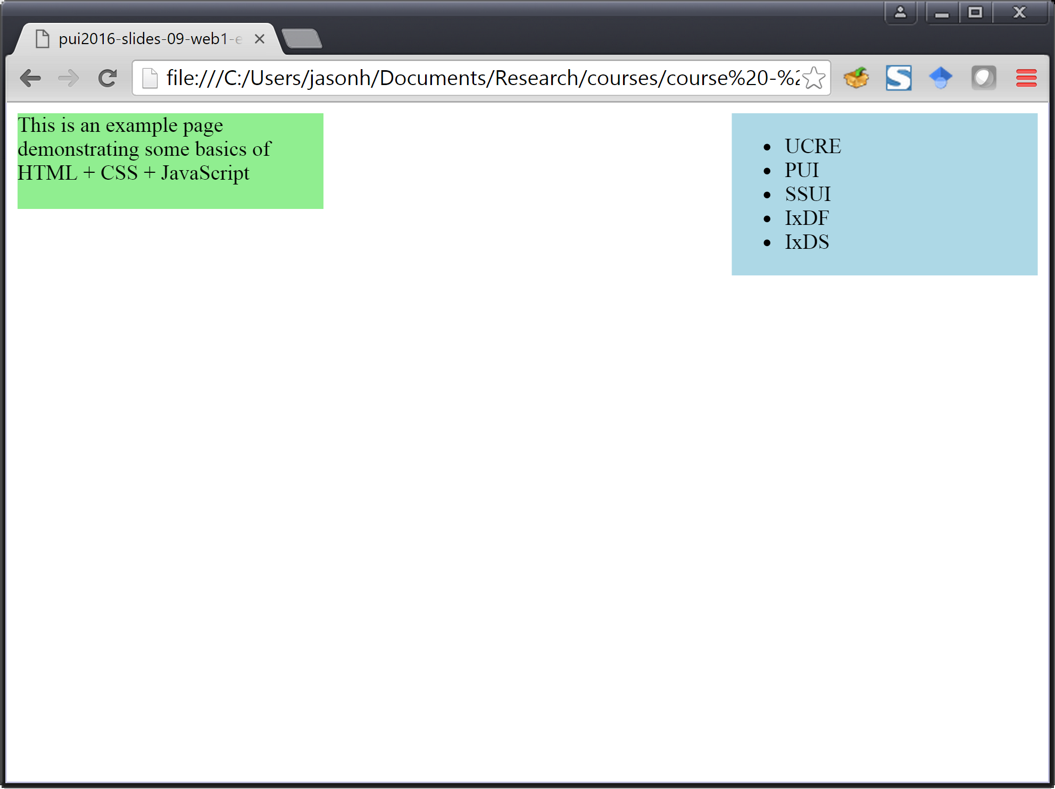

Slide 13
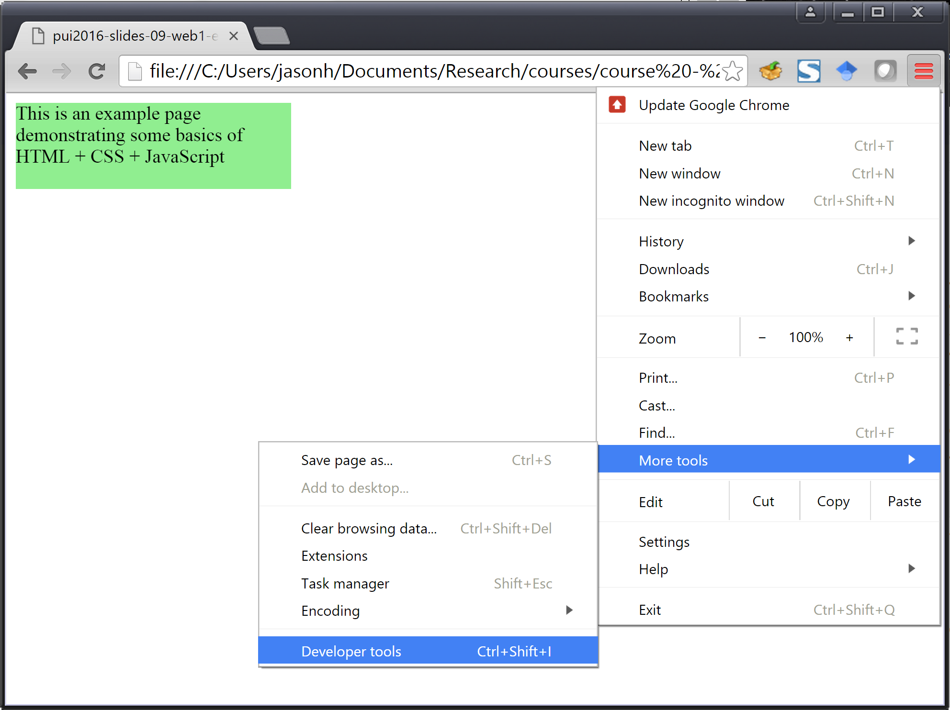

Slide 14
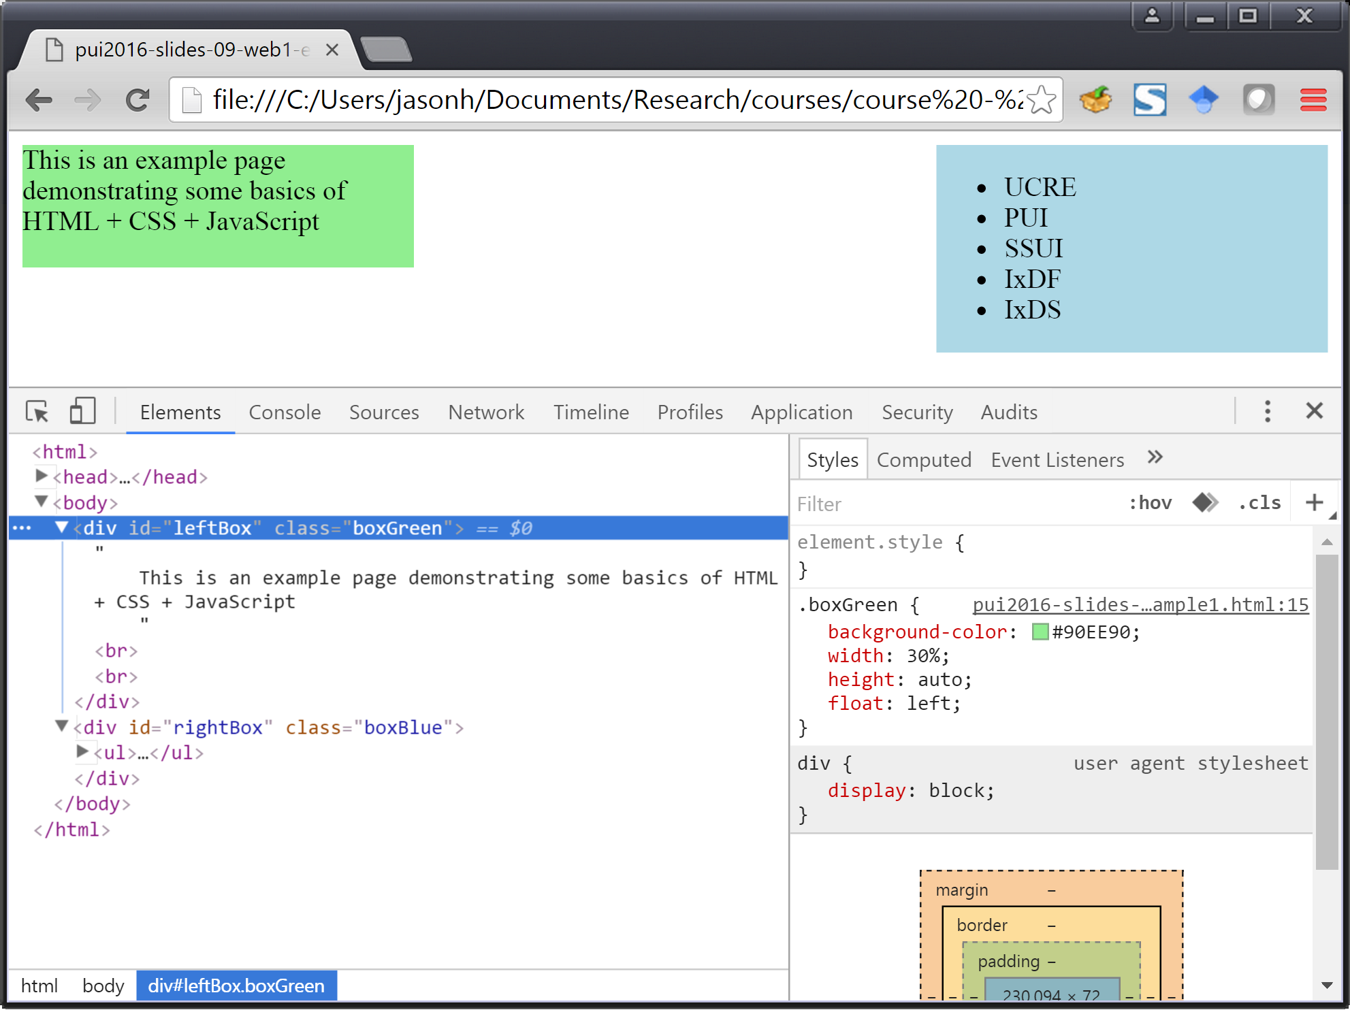

Slide 15
Now Let’s Change the DOM
This is where basic JavaScript comes in
We’ll use the Chrome console to modify the web page on the fly
Remember how “document” was the root node of the tree?
This is the object through which we will access most of the DOM
document is predefined object
document
head
title
body
h1
“hello”
div
“some text”
“hello world!”

Slide 16
Some Useful Methods
document.getElementById()
IDs are supposed to be unique in a page
Returns a single HTML element object
document.getElementsbyClassName()
Class names not unique, ex. comment, buttons, etc
Returns an array of HTML elements
ID and class here are same concept as for CSS
#idname in CSS (unique, or supposed to be)
.classname in CSS (can have multiple)

Slide 17
Let’s Do An Example
<body>
<div id="leftBox" class="boxGreen">
Some basics of HTML + CSS + JavaScript
</div>
<div id="rightBox" class="boxBlue">
<ul>
<li>UCRE
<li>PUI
</ul>
</div>
</body>
</html>

Slide 18
Example: Delete Box on the Right
boxOnRight = document.getElementById("rightBox");
boxOnRight.remove(); // removes itself
Some notes
boxOnRight is a variable, could name it anything
Note parameter passed to getElementById()
Also, note that it’s not getElementByID()
Once took me a while to debug that one
Let’s try that too to show example of error message

Slide 19
Example: Change Box Color on Right
boxOnRight = document.getElementById("rightBox");
boxOnRight.style.backgroundColor = "orange";
Some notes
Some things are functions, some things are variables
Hard to always know upfront without looking it up
Alternatively, just try one, and browser will (usually) let you know you made an error

Slide 20
Example: Change Box Color on Right
Note that JavaScript often fails silently, can make debugging rather difficult
boxOnRight = document.getElementById("rightBox");
boxOnRight.style.backgroundCOlor = "orange";
Notes:
obj.style.backgroundCOlor (typo, but it silently creates a new variable if you assign something)

Slide 21
Example: Change Content in Box
textnode = document.createTextNode("This is new.");
boxOnRight.appendChild(textNode);
Some notes:
Ok another bug here, boxOnRight not defined
Ok another bug here, textnode != textNode (note case sensitivity)

Slide 22
Example: Change Parent
boxOnLeft = document.getElementById("leftBox");
boxOnLeft.parentElement.style.backgroundColor = "#BEEFED";
Some notes:
Hexadecimal is base 16 (so A == 10, and F == 15)
Programmers like making silly hex jokes
Ex. 0xDEADD00D or 0xBADDCAFE or 0x8BADF00D

Slide 23
Web Programming Tips
Build things up from small parts first
Test things inside console one piece at a time
Then put together into actual code
Learn how to lookup APIs
http://www.w3schools.com/jsref/
https://developer.mozilla.org/en-US/docs/Web/API/Node
Look things up on Google
Look things up on StackOverflow
Save early, save often (revision control)

Slide 24
Questions So Far?

Slide 25
Graphical User Interfaces
A lot of what we just talked about is true for almost all Graphical User Interfaces
Windows / Mac, Android / iOS, Web
Today, general principles and organization of GUIs
Help you understand how to think like CompSci
Clearer mental model of underlying internals
Will help if you do prototyping on another platform
(PUI) Will help you talk with developers
(SSUI) Will help you understand more of the internals

Slide 26
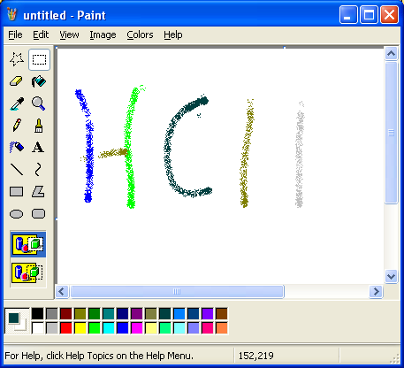
How are GUIs (roughly) Organized?
WIMP
Windows
Icons
Menus
Pointer
User in charge
Can click anywhere
Can interact w/ any window
But internally, how does a GUI work?

Slide 27
One Possibility for GUIs
This is how many people think GUIs are structured
Good in that user interface cleanly separated from application (separation of concerns)
That is, different functionality not intermingled in code
UI
graphics layout mouse / keyboard
Appl
data networkingbiz logic

Slide 28
Another Possibility
Can break this down further
Imagine UI Core is the engine that makes it all work
Input
App
Interface
UI
Core
Appl
Output

Slide 29
Another Possibility
Basic flow in this model
Input
App
Interface
UI
Core
Appl
Output

Slide 30
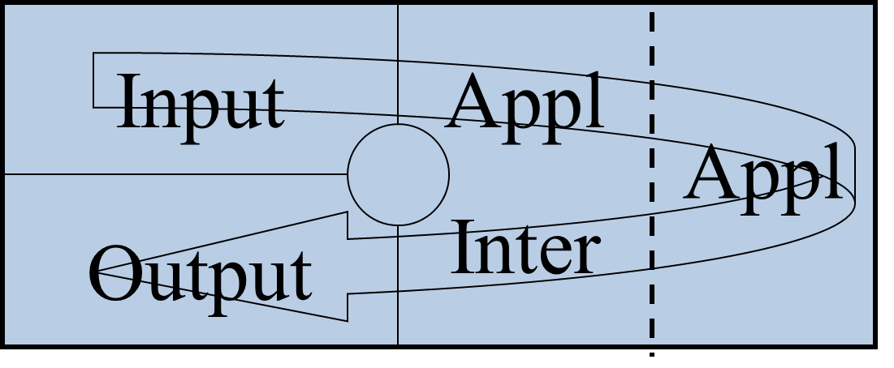
Some Early GUIs were built this way
Early GUIs tried this, didn’t work well in practice
Unwieldy to manage all input in one place in code, all output in another (hard to understand)
Tight coupling: Changing UI requires changing input code and output code (error prone, hard to modify)
Not modular: no easy way to reuse code (error prone, time consuming)
Notes:
Need better, higher-level, and reusable abstractions

Slide 31
Desirable Programming Properties
Easy to understand
Easy to modify (not error prone, loose coupling)
Easy to reuse
Clean and higher-level abstractions
These are properties that programmers like in general for all source code
In our case, source code == HTML, CSS, JavaScript

Slide 32
Key Idea #1 Object-based Organization
Every element on the screen is an object
Same idea of input / output / state, smaller granularity
Each object has its own behaviors and states
Can draw itself (checkbox looks like a checkbox)
Can handle its own input (checkbox can handle presses)
Has internal state (checkbox text, color, checked or not)
In
Appl
TextArea2
Out

Slide 33
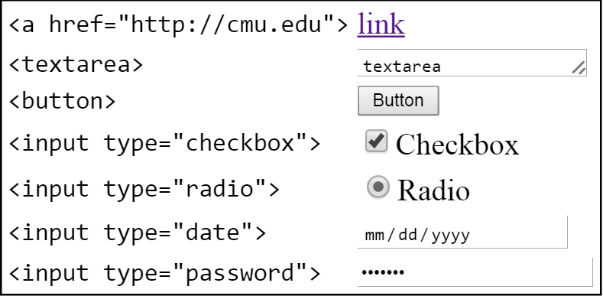
HTML Examples of Widgets
Widgets, controls, components, interactors
Terms for highly reusable interactive components

Slide 34
Creating a GUI Then Consists Of…
Selecting appropriate widget for a particular task
Positioning that widget in a window
HTML: Organizing into <div> and doing CSS
Modifying widget properties for look and feel
Ex. Color, size, text, image
HTML: Anything related to CSS
Adding code so widget does right thing on {click, dblclick, mouseover, etc}
This is where JavaScript comes in
More on this in lab and later today

Slide 35
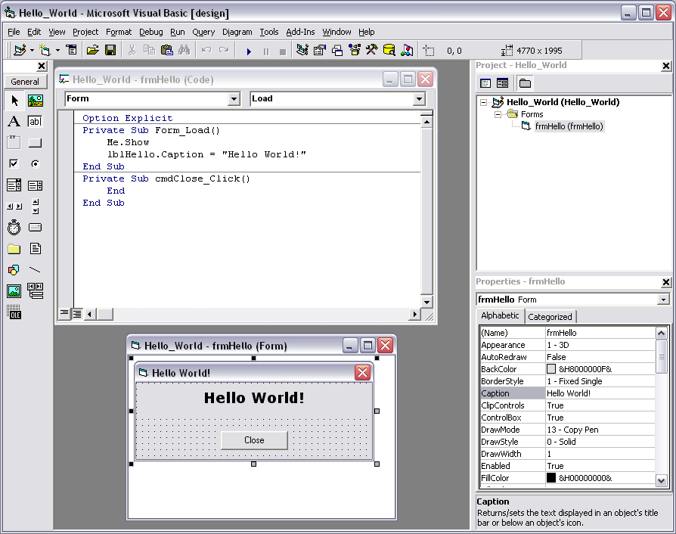
Key Idea #2: Object-based organization
Notes:
Visual Basic example, note how it has the major parts
Layout, properties, code

Slide 36
Widget Approach has Good Properties
Loose coupling, easy to modify
Set properties to change color, drag to change position
Modifying one button doesn’t impact other widgets
Modular
All code relating to buttons is in the button widget
Easy to reuse
Drag and drop / add HTML tag
Clean and higher-level abstraction
“Buttons” and “checkboxes” rather than “functions”
Reduces complexity, hides lots of details from devs

Slide 37
Key Idea #2 Component Trees
Every GUI has something like the DOM
Tree data structure, spatial containment of widgets
Everything is done through this tree
Build an interface == build tree
Change an interface == change tree
Several alternative names
Interactor trees, Component trees, etc
Note: how to create tree is different for different platforms
document
head
title
body
h1
“hello”
div
“some text”
“hello world!”

Slide 38
Component Tree Example

Slide 39
Component Tree Example
“untitled - Paint” window
Menu Bar
File
Edit
…
Paint Toolbar
…
Color Palette
Scrollable Panel
Horizontal Scrollbar
Vertical Scrollbar
Drawing Canvas
…

Slide 40
Component Tree Example
“untitled - Paint” window
Menu Bar
File
Edit
…
Paint Toolbar
…
Color Palette
Scrollable Panel
Horizontal Scrollbar
Vertical Scrollbar
Drawing Canvas
…

Slide 41
Notes on Component Trees
Position of child nodes are relative to parent node
Top left of parent is always (0,0)
(0,0)
(30,30)

Slide 42
Notes on Component Trees
Position of child nodes are relative to parent node
Top left of parent is always (0,0)
(0,0)
(0,30)

Slide 43
Notes on Component Trees
What is this selected
widget’s position?
(assume x is 15)
Position of child nodes are relative to parent node
Top left of parent is always (0,0)
(0,0)
(0,30)
Notes:
Has two different positions
One is relative position, which is (15, 0)
One is absolute position, which is (15, 30)

Slide 44
Position
The right answer is … it depends
Relative to its parent is (15, 0) <-- most common
Relative to the window is (15, 30)
Relative to screen is … depends on where window is
Where top-left of your screen is (0, 0)
Note: for HTML, typically don’t specify locations, web browser takes care of layout for you
Note: this concept of position will come up again shortly for mouse events

Slide 45
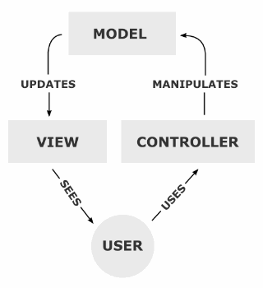

Key Idea #3: Model-View-Controller (MVC)
Common programming design pattern for GUIs
Basic idea: split widget into three separate objects
Each part handles different aspect of widget
Appl
Out
In

Slide 46
Model-View-Controller
View handles everything related to output
Controller handles everything related to input
Model handles data related to widget
Model can be simple as an integer for a counter, or string for an text entry box
Or as complex as a molecular simulator
A model can have more than one view and one controller

Slide 47
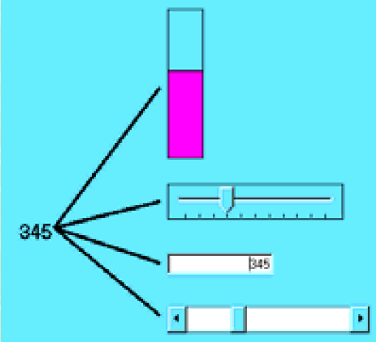

In-Class Quiz (ungraded)
Spend 3 minutes to draw underlying MVC for this GUI example
Four widgets showing a value
Changing one changes all four
Draw out the Model(s), View(s), and Controller(s)
Sketch out what happens when user drags the bar widget
Note: a model can have more than one view and one controller

Slide 48
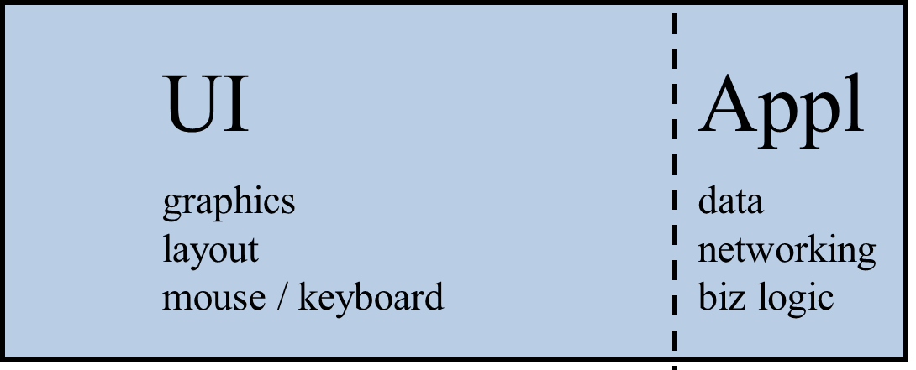
So What? Why Care about MVC?
MVC very common design pattern for software
Separate presentation (how UI looks and feels) from both data and logic (what happens when you click)
So the diagram we started with is still good idea for how programs should be structured
Just need to be finer-grained
Instead of organizing entire app like this, org each widget instead like so
Notes:
Separation of concerns (again)

Slide 49
So What? Why Care about MVC?
MVC is a really powerful design pattern
Useful for organizing at small scale (widgets)
Useful for organizing at big scale (data and app logic) from look and feel
For typical GUI and web programming, note that you won’t use MVC at small scale directly
You just use widgets, everything taken care of for you
You should, however, use MVC at larger scale
Organizing code and overall structure of app
Keep UI code separate from behavior / business logic

Slide 50
So What? Why Care about MVC?
Note many frameworks also talk about MVC
Ex. AngularJS, EmberJS, JavaScriptMVC
Ex. Django, Rails, ASP.NET
They all use MVC in slightly different ways, but share similarities in separation of concerns
Example application logic (model)
Number of login attempts allowed
Adding item to shopping cart
Purchasing items (and charging credit card)
Core part of these is Model

Slide 51
So What? Why Care about MVC?
Note that MVC sort of maps onto HTML
HTML is part of the model (the data shown to users)
CSS is view (how it appears)
JavaScript is controller (advanced behavior)
Not clean mapping b/c distributed and b/c MVC is for programming languages with more structure
Do note separation of concerns here
Do note modularity and loose coupling here
Will discuss evolution of these next time

Slide 52
Controller
View
Model
Controller
View
Controller
View
Controller
View

Slide 53
User interacts with bar widget (controller)
Controller processes mouse input and tells model to increment
Controller
View
1
2
Model
Controller
View
Controller
View
Controller
View

Slide 54
3. Model updates all views (so that what they show is consistent)
Controller
View
3
Model
Controller
View
3
Controller
View
3
Controller
View
3

Slide 55
Administrivia
HW5 assigned
We were a bit late in getting assignment out
Assignment is also harder than previous (start early)
Push deadline back for PUI and SSUI to Sunday Oct 7 at 11:59pm

Slide 56

https://www.youtube.com/watch?v=2Y_Jp6PxsSQ

Slide 57
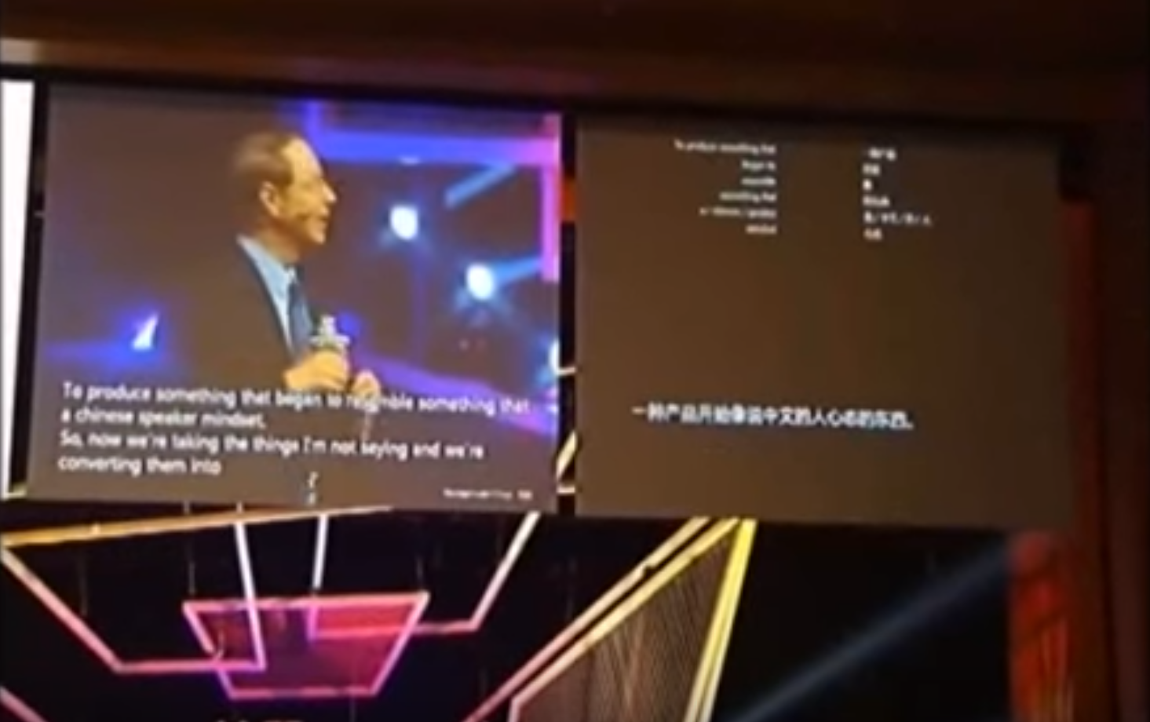
https://www.youtube.com/watch?v=a2VlPaHeFgE

Slide 58
How to Handle Input?
Concepts we’ve talked about so far are about output and internal state
Widgets, DOM, MVC
How do we handle input?
HTML + Browser defines some easy input
Links, buttons, checkboxes, etc
How to handle other input? And more sophisticated behaviors?

Slide 59
Event-Driven Programming
All input from user to computer done via events
mouse button ‘left’ went down
item ‘New Folder’ is being dragged
keyboard button ‘A’ was hit
keyboard focus event
…
This is known as event-driven programming
All GUIs work this way

Slide 60
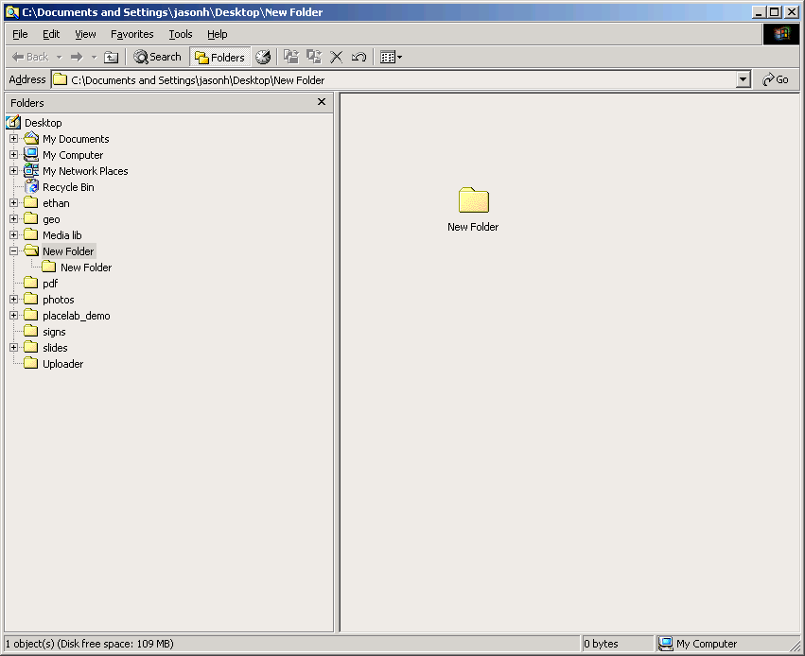

Event-Driven Programming
Icon -> Mouse entered
-> Mouse moved
-> Mouse moved
-> Mouse moved
-> Mouse pressed
-> Mouse dragged
-> Mouse dragged
-> …

Slide 61
Web Examples
<div id="thebluebox" class="boxBlue" onmousedown="console.log(event)">
This is a div that logs mouse events to console. I put in lots of breaks to facilitate scrolling.
</div>
Example 1: Prints the entire mouse event
https://goo.gl/MLHVo4
Example 2: Prints important parts of the mouse event
https://goo.gl/4sZPVw

Slide 62
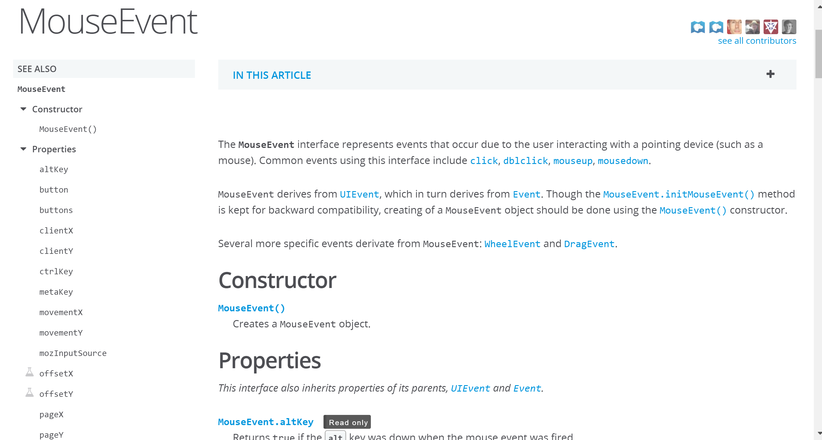
Events Have Useful Properties
https://developer.mozilla.org/en-US/docs/Web/API/MouseEvent

Slide 63
Mouse Events
target - which HTML element
button - which button(s)
clientX / clientY - relative to current view
pageX / pageY - relative to top of page
screenX / screenY - relative to screen

Slide 64
Web Examples
Display all mouse events that happen in a box
Standard HTML + JavaScript version
https://goo.gl/kn55SM
JQuery version (equivalent, useful comparison)
https://goo.gl/Vtr49z

Slide 65
Web Examples
The code for handling events has many names
Handler, event handler, callback
This is the part of the code that is called for you when the event happens on a given widget
onmousedown(), onmousemove(), onkeypress()
Observer software design pattern
Add listeners to an object, listeners get state updates
Android, iOS, Java Swing, web all work like this
Q: in original Java AWT toolkit, had to subclass Button and override mouseDown(), why was this a bad idea?
Notes:
Answer:
(1) Ended up with lots of small classes for GUI (annoying)
(2) Higher developer time and overhead to do simple things (vs a callback / listener)
(3) Tighter coupling (potential for error in subclassing, won’t accidentally shoot self in foot with listener)
(4) Understanding the code (developer has to inspect the subclassed Button to see if what it does and to understand if it has any unusual behaviors, vs just a listener)

Slide 66
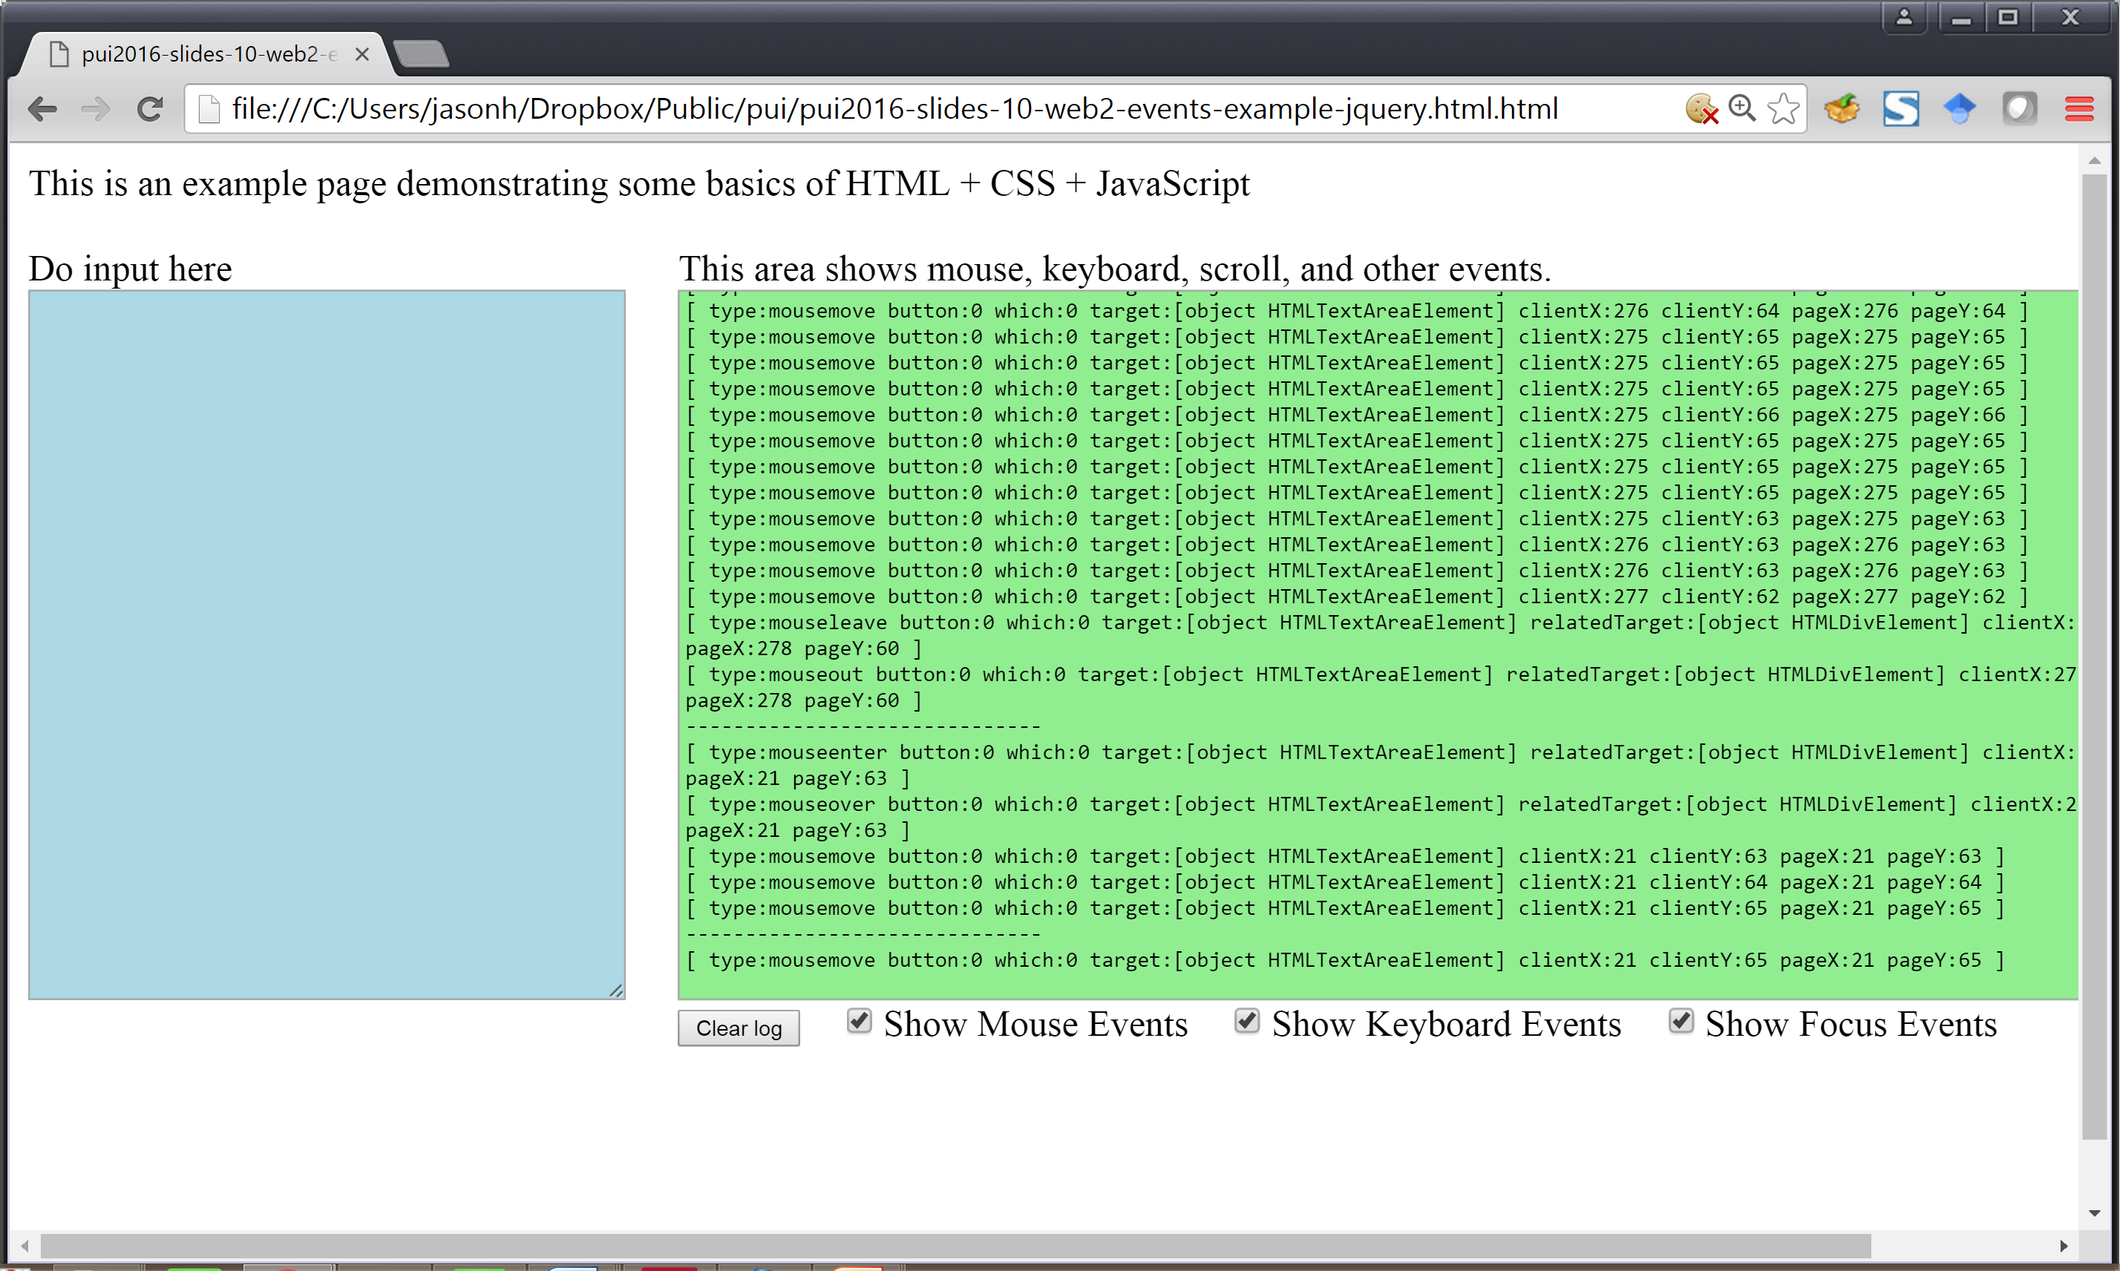

Slide 67
Other Example Events
Mouse events
Keyboard - key up, down, pressed
Focus - where input goes to
Drag events
Many, many, many more
http://www.w3schools.com/jsref/dom_obj_event.asp

Slide 68
Event-Driven Programming
All generated events go to a single event queue
Provided by operating system or GUI toolkit
Why have an event queue?
Why add a level of indirection?
Why not send event immediately to application?
Mouse
Software
Event Queue
App
Keyboard
Software
Notes:
Why event queue? See last slide in this deck.
- Ensures correct temporal ordering of events (very very important)
- Allows us to hack on things (can coalesce events together, e.g. mouse motion)
- Offers level of indirection, making it easy to support new kinds of inputs in the future (e.g. speech or other pointers)
- Offers loose coupling, so that apps don’t need to know what specific input devices are generating the input

Slide 69
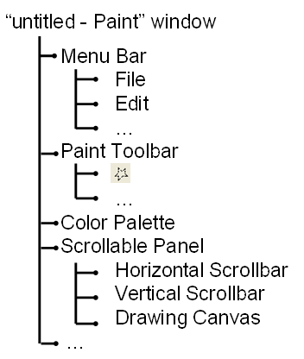
Tying it All Together
while (app is running) {
get next event
send event to right widget (dispatch)
}
Mouse
Software
Source
Code
onClick()
onKeyDown()
…
Events
Keyboard
Software

Slide 70
Tying it All Together
Source
Code
onClick()
onKeyDown()
…
Mouse
Software
Events
Keyboard
Software
These are done automatically for you
Low-level input
Event queue
Widget management (click, move, draw)
Tree data structure
You do this
What widgets to use
Layout of widgets
Behavior when used
Data model

Slide 71
Some Important Gotchas Mostly for CompSci Folks
There is one main event thread that is reading in events and dispatching to the right callback
What happens if you (for example) make a slow database query onmousedown()?
Source
Code
onClick()
onKeyDown()
…
Mouse
Software
Events
Keyboard
Software
Notes:
Common GUI bug: don’t do slow operations on the main event thread
Solution is to do things asynchronously. Pretty much every toolkit has a way of doing things asynchronously and then getting notifications when done.

Slide 72
Summary
All modern GUIs organized along these lines
Widgets / Component Trees / Model-View-Controller
Loose coupling / separation of concerns / reuse
Event-driven programming
Lots to modern GUIs, but easy to use
You select widgets, do styling + layout, add callbacks

Slide 74
Example: Change Content in Box (1/2)
boxOnLeft = document.getElementById(“leftBox");
boxOnLeft.innerHTML = "<b>this is the new text</b>";
Some notes
(Un)intentional bug, fix the quote mark
Get used to error messages

Slide 75
Example: Traverse Children
var list = document.getElementById("rightBox"). children[0].children
for (var i = 0; i < list.length; i++) { console.log(list[i]);
}
Some notes:
console.log() super useful for debugging
This is also really complex too (hence JQuery)

Slide 76
Example: Get By Class Name
document.getElementsByClassName("boxGreen");
Some notes
Note that it’s plural, getElementsByClassName
Returns an array of matches

Slide 77
Help For Implementing Systems?
Key ideas so far
Widgets
Component Trees
Model-View-Controller
Now, let’s look at same concepts as layers
Layers basic approach for organizing things in CompSci
What layers are there for GUIs? What responsibilities?
Help with mental model of how things organized

Slide 78
Layers of UI Software
Application Program
“High-Level” Tools
Tools Supporting Each Layer
Toolkit
Window System
OS
Hardware

Slide 79
Example: Android
Application Program
“High-Level” Tools
Also part of Android OS, handles display of apps
Toolkit
Window System
OS
Android OS
Hardware
Android Phone

Slide 80
Example: Android
Libraries for game engines, advertising, Facebook, etc
Application Program
“High-Level” Tools
Toolkit
Handles widgets (look and feel)
Window System
OS
Hardware

Slide 81
Layers of UI Software (Commercial)
Application Program
“High-Level” Tools
Tools Supporting Each Layer
Toolkit
Operating System
Window System
OS
Hardware

Slide 82
What About HTML / CSS / JavaScript?
Application Program
JQuery
Node.js
React
Meteor
Libraries
“OS”
Parser Networking
Layout Engine JavaScript Engine
Render Engine Security
Manages resources
Hardware
Notes:
Browser is essentially an OS at this point

